Slide 1
First Deep Neural Network(DNN) Using KERAS
Kristopher Keipert
November 23, 2020

Slide 2
Agenda
Deep Learning Approach
Frameworks
Keras
Splitting the Data Set
Horovod
Seven NN Stages
Basic Visualization
Model Summary

Slide 3
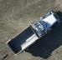



Deep Learning Approach
LABELLED TRAINING DATA
DEEP NEURAL NETWORK
“MODEL”
OBJECT CLASS PREDICTIONS
input
prediction
CAR
TRUCK
DIGGER
BACKGROUND
error ~ (label – prediction)
Back-propagate errors for parameter update

Slide 4
Deep Learning Approach
LABELLED TRAINING DATA
DEEP NEURAL NETWORK
“MODEL”
OBJECT CLASS PREDICTIONS
input
prediction
CAR
TRUCK
DIGGER
BACKGROUND
Need LOTS of data
Millions+ of images
Divide Data into 2 Groups:
Training Data (67-80%)
Validation Data (20-33%)
Have test data available
error ~ (label – prediction)
Back-propagate errors for parameter update

Slide 5
Which FrameWork should I pick?
Loads of possibilities
Tensorflow
Caffe2, NVCaffe
PyTorch
MXNet
Microsoft Cognitive Toolkit
Paddle, Paddle
Chainer
PlaidML
Theano
Torch
Which one should you pick?
Frameworks change quickly
Lots of interface options:
Python, C/C++, R, Julia, Matlab, Perl, Wolfram Language, Java (There is a Fortran framework!)
Pick a framework to get started
Make sure it supports your interface language
You can always change later
Or - Pick a higher-level tool such as Keraseras

Slide 6
Perceptron

Slide 7
Single Perceptron
Fundamental building block for many Neural Networks or parts of networks
Using several perceptrons can create MLP – Multi-Layer Perceptron
Better known as a Neural Network
Dates back to the 1950’s
Great for binary classification (is it a cat or not?)
Also works for multi-class classification (is it a cat, dog, chipmunk, bicycle?)
Idealized, simple model of neuron (artificial neuron)

Slide 8
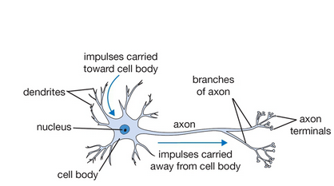
Artificial Neurons
Artificial neuron
y
Biological neuron
y
w₁
w₂
w₃
x₁
x₂
x₃
Weights (W_{n}) = parameters
From Stanford cs231n lecture notes
y=F(w₁x₁+w₂x₂+w₃x₃)
Notes:
The workings of artificial neurons in a neural network are inspired by the neurons found in the brain
- Deep Learning is based on building deep networks of artificial neurons.
Artificial neurons are a inspired by a model of a biological neuron
Artificial neurons are a linear combination of weights and one or more input

Slide 9
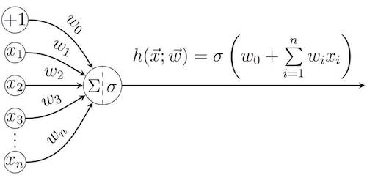
Single Perceptron
Single Perceptron
Very simple model:
N input signals (x₁ .. x_{n})
N weights (w₁ .. w_{n})
1 Bias (w₀)
σ is activation function
Relu, sigmoid, heavyside
N weights (w₁ .. w_{n}) and bias, w₀, are “Design variables”
These are “discovered” by training
No Human intervention or coding
Y = Σ (weight * input) + bias

Slide 10
Critical Model items
Need to define the number of inputs
The layer needs to be initialized (usually random numbers)
Weights and bias
Specify the activation function (F)
ReLU
Sigmoid
Softmax
Tanh
Linear
Artificial neuron
y
w₁
w₂
w₃
x₁
x₂
x₃
y=F(w₁x₁+w₂x₂+w₃x₃)

Slide 11
Activation Functions
These are very key to training!
They can greatly improve learning or just make it a flop
In these slides, the focus is on numerical data
No images – No Convolutions
Knowledge is not wasted because at some point you will need to classify images
These activations functions are VERY useful for classification
What if you mix image and numerical data?

Slide 12
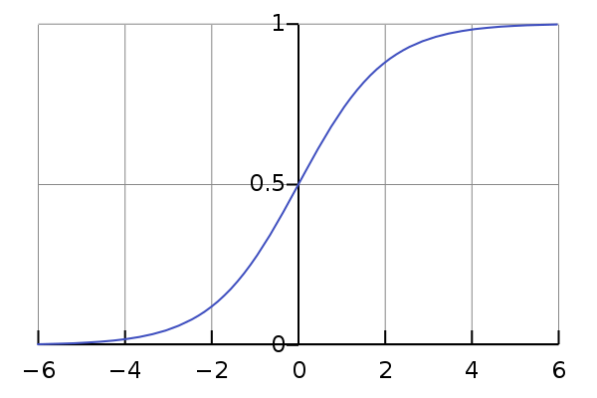
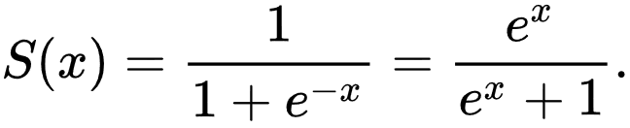
Activation Function
Sigmoid
The sigmoid function in the output layer
‘sigmoid’ in Keras
Special case of a logistic function
Differentiable
Using a sigmoid on the output layer ensures our network output is between 0 and 1
Easier to map to either a probability of class 1 or snap to a hard classification of either class with a default threshold of 0.5
Saturates and kills gradients
keras.activations.sigmoid(x)
Notes:
http://dataaspirant.com/2017/03/07/difference-between-softmax-function-and-sigmoid-function/
Used for binary classification in logistic regression model.

Slide 13
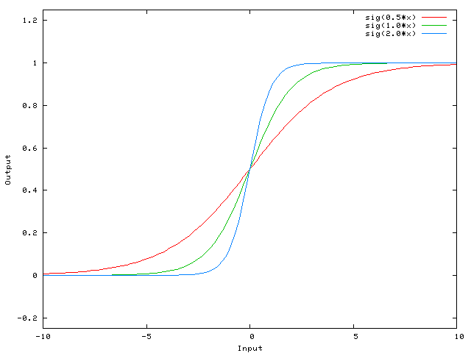
Impact of Weights on Activation Function
Sigmoid

Slide 14
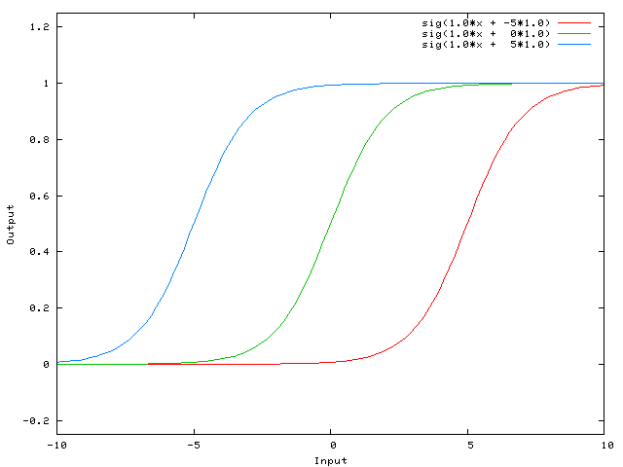
Impact of Bias on Activation Function
Sigmoid

Slide 15
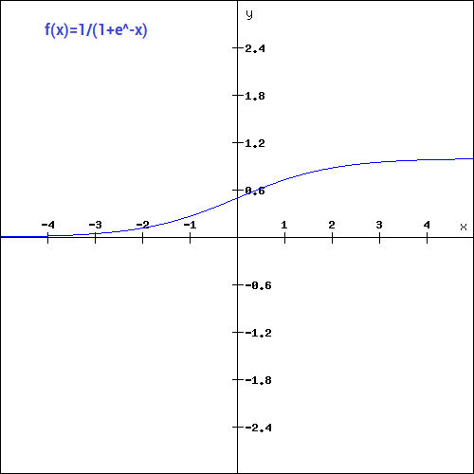
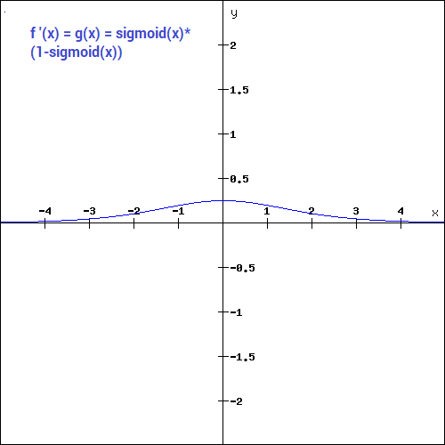
Gradient of Sigmoid

Slide 16
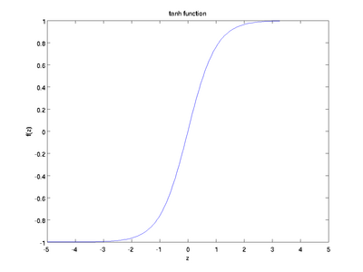
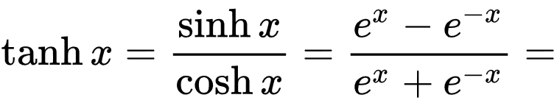
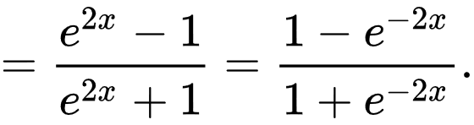
Activation function
Tanh
Hyperbolic Tangent (In Keras, ‘tanh’)
Values between -1 and 1
Differentiable
Scaled Sigmoid function

Slide 17
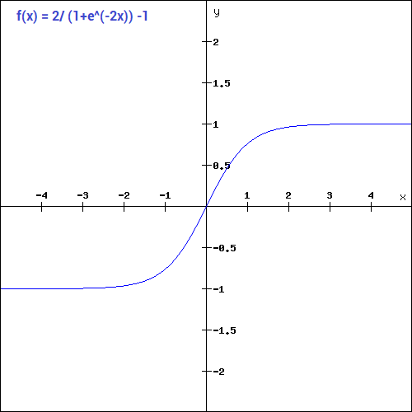
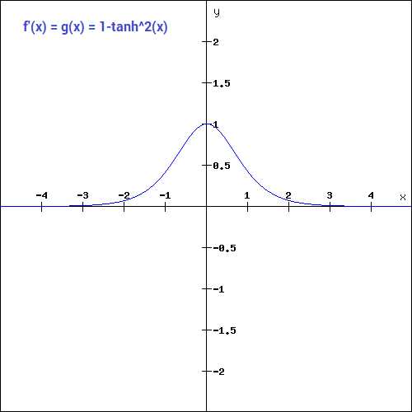
Tanh - gradient

Slide 18
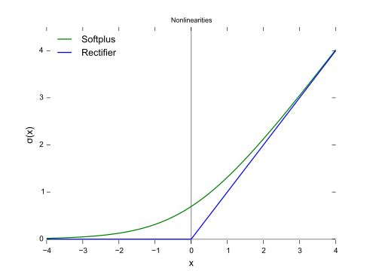
Activation function
ReLu
Rectified linear unit activation function. In Keras (‘relu’)
f(x) = max(0,x)
Better training performance is usually achieved using relu
Analytical derivative wrt x, but not continuous
Smooth approximation:
f(x) = log (1 + exp(x) )
Softplus function
Analytical derivative wrt x
Excellent initial activation function

Slide 19
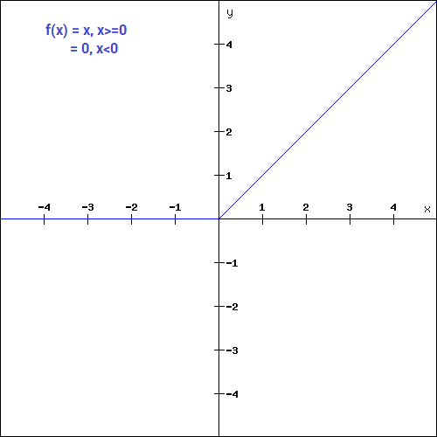
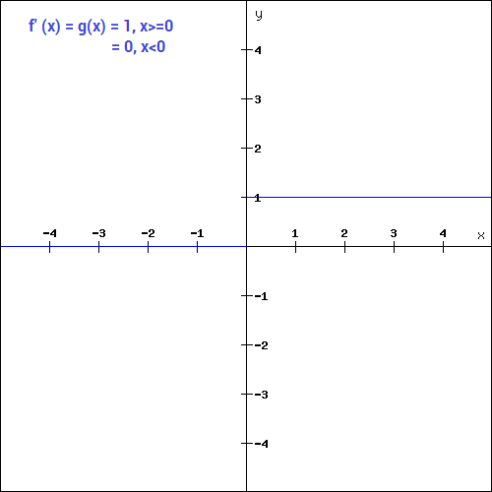
RELU Gradient

Slide 20
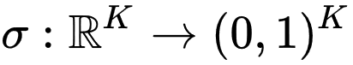
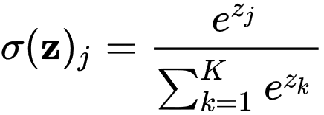
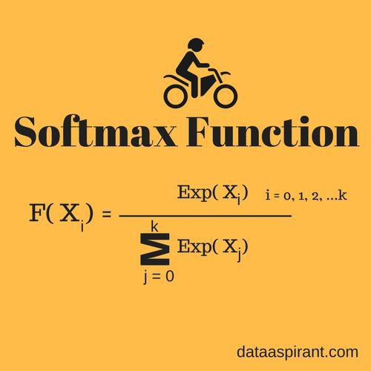
Activation Function - softmax
In mathematics, the softmax function, or normalized exponential function, is a generalization of the logistic function (In Keras, ‘softmax’)
Neural Networks are commonly trained under a log loss (or cross-entropy) regime
Probabilities will be in range of 0 to 1
Sum of all probabilities is 1

Slide 21
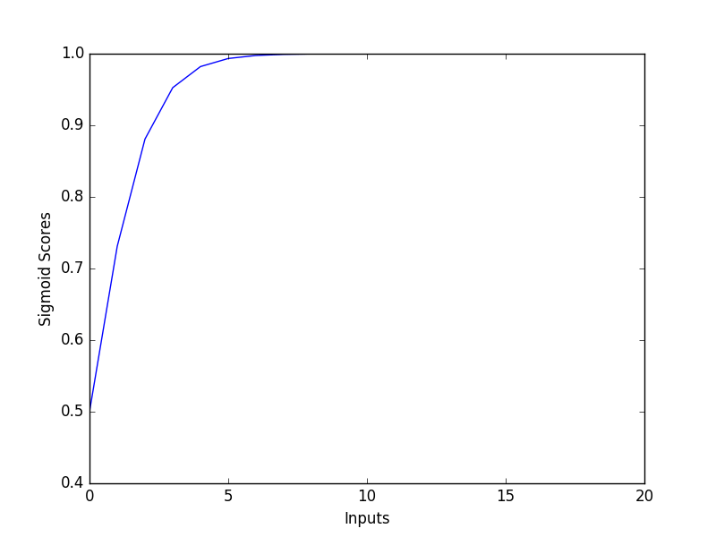
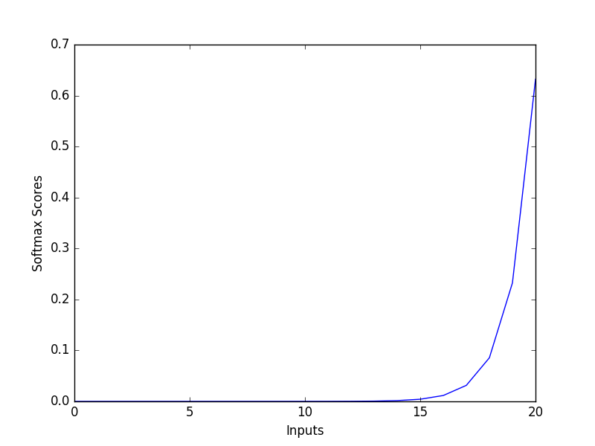
Sigmoid vs. softmax

Slide 22
Swish Python Code in Keras
from keras.backend import sigmoid
def swish(x, beta = 1):
return (x * sigmoid(beta * x))
Create your own “swish” function for Keras
from keras.utils.generic_utils import get_custom_objects
from keras.layers import Activation
get_custom_objects().update({'swish': Activation(swish)})
model.add(Flatten())
model.add(Dense(256, activation = “swish”))
model.add(Dense(100, activation = “swish”))
model.add(BatchNormalization())

Slide 23
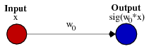
Role of bias
Biases are almost always helpful
In effect, a bias value allows you to shift the activation function to the left or right, which may be critical for successful learning
The NN “discovers” the bias value
Typically one per neuron
Weights determine “steepness” of curve
Bias shifts entire curve left or right

Slide 24
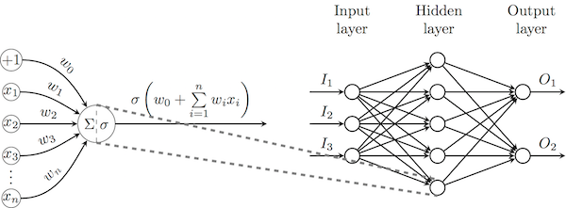
Multi-layer perceptron
Multi-layer Perceptron – several perceptrons
Includes bias (w₀) per neuron
Cybenko's universal approximation theorem, a (wide enough) MLP with a single hidden layer of sigmoid neurons is capable of approximating any continuous real function on a bounded interval
The proof of this theorem is not constructive, and therefore does not offer an efficient training algorithm for learning such structures in general

Slide 25

Multi-layer perceptron
Conceptually simple by defining layers
For many years 0-1 “hidden layers” were used
“hidden” means they are not the input or output
Deep Neural Network can have tens, hundreds, or thousands of hidden layers
Many neurons in layers
All neurons in one layer are connected to neurons in previous layer and in next layer (left to right)
FCN = Fully Connected Network

Slide 26
Multi-Layer Perceptron - Parameters
There are unknown parameters that are found via training
Weights (1 per connection from layer to layer)
Bias (1 per neuron)
They are found by “reducing” the error (optimization problem)
Error = Correct output – Computed output
You do not have to program these parameters nor a way to discover them
The NN does this for you (“Software writing software”)

Slide 27
Multi-Layer Perceptron - Parameters
During training, the Neural Network determines the weights and biases (design parameters)
Can result in a HUGE number of parameters
GPT-2 8B
Transformer-based language model for generative language modeling
Designed to predict and generate text (e.g.- write the next sentence in a document given the initial paragraph)
8.3B parameters
GPT-3 175B
We have no real control of the design parameters during training

Slide 28
Multi-Layer Perceptron - Parameters
Sometimes interesting things happen during training and none of it is under our control
The NN discovers relationships between inputs and the outputs WITHOUT human intervention
Sometimes these relationships are new (previously not known)
Gives rise to the concept of “artificial intelligence”

Slide 29
First Neural Network

Slide 30
KERAS- What is Keras?
High-level Neural Network API (Python, R)
Written in Python
Started out as interface capable of running on top of TensorFlow, CNTK, Theano, MXNet, PlaidML
As of Keras 2.8.3, it is frozen for all but TensorFlow
Moving forward it will be developed only in TensorFlow (it’s the main Python coding interface)
Supports Fully Connected networks (FCN), convolutional networks (CNN), and recurrent networks (RNN) (also LSTM’s)
Runs on CPU and GPU
Horovod integration (Distributed training framework)

Slide 31
Horovod – What is Horovod?
Developed by Uber (open-source)
Distributed training framework for TensorFlow
Distributed compute resources (i.e. multi-gpus/node and multi-node)
Integrates extremely well with Tensorflow.Keras
Easy to take a single-GPU TensorFlow model and successfully train it on many GPUs (faster, larger models, larger data sets)
Built on MPI
Can use mpi4py (need multi-thread performance)

Slide 32
Keras Installation – Python 3
Install Keras:
pip install keras
conda install keras
Also installs tensorflow (backends)
Can install GPU version (tensorflow-gpu)
Check:
python -c "import keras; print keras.__version__”
python -c "from keras import backend; print backend._BACKEND“
KERAS_BACKEND=theano
python -c "from keras import backend; print(backend._BACKEND)"

Slide 33
First Neural Network
Classifier/Predictor
Pima Indian Nation - onset of diabetes dataset
Originally from National Institute of Diabetes and Digestive and Kidney Diseases
Objective of the dataset is to diagnostically predict whether or not a patient has diabetes, based on certain diagnostic measurements included in the dataset
Predictor variables:
Pregnancies: Number of times pregnant
Glucose: Plasma glucose concentration a 2 hours in an oral glucose tolerance test
BloodPressure: Diastolic blood pressure (mm Hg)
SkinThickness: Triceps skin fold thickness (mm)
Insulin: 2-Hour serum insulin (mu U/ml)
BMI: Body mass index (weight in kg/(height in m)^2)
DiabetesPedigreeFunction: Likelihood of diabetes w.r.t. family history
Age: Age (years)
Outcome: Class variable (0 or 1): 0 = no diabetes, 1 = diabetic

Slide 34
First Neural Network
The data is in csv format
https://raw.githubusercontent.com/keipertk/fdnn/master/pima-indians-diabetes.data.csv
Goal:
Develop model that can predict if a patient is diabetic or not, based on test data

Slide 35
First Neural Network
Data Exploration
Categories (Input) - 8
Output (Label) - 1
Diabetic
Yes = 1
No = 0
Number of pregnancies
Blood Pressure
Skin Thickness
Glucose
Insulin
BMI
DPF
Age
Label
(Ground Truth)
Categories

Slide 36
NN Training stages
Create data
Load data
Define Model
Compile model
Fit model (train!)
Evaluate Model
Predictions (Inference)

Slide 37
1. Create Data
Perhaps the most difficult step (can be over 50% of your time and as much as 80%)
Gather data, look for outliers, filter it, examine data (plot it, statistical analysis)
Descriptive Statistics
Data range, median, mean, deviations, moments, etc. Logistic regression analysis.
Plot the data!!!
Create labels
If you think you have enough data, you need more ☺
Can derive new data from existing data (image data)
Need lots of variety (if possible)
May need to normalize, scale, perhaps even rotate data
Label data!!

Slide 38
2. Load Data – Load Data Into Python
from keras.models import Sequential
from keras.layers import Dense
import numpy
# fix random seed for reproducibility
numpy.random.seed(7)
# load pima indians dataset
dataset = numpy.loadtxt(
"pima-indians-diabetes.data.csv",
delimiter=",")
# split into input (X) and
# output (Y) variables
X = dataset[:,0:8]
Y = dataset[:,8]
Pretty straightforward
In our case, csv data (use numpy)
Can be database (useful for images)
X is “input” or predictor values – 8
Numpy list (array)
Y is output (output) – 1
Numpy list (array)

Slide 39
3. Define Model
In Keras, the model is defined as a sequence of layers
Create a Sequential model and add layers one at a time
In this example, we will use a fully-connected network structure with three layers
FCN means every neuron in one layer is connected to every neuron in the next layer
Classic Multi-Level Perceptron
Designing layers is something of an art
Experiment
Steal!!! (transfer learning)
Fully connected layers are defined using the Dense class in Keras

Slide 40
3. Define Model
Initialize the network weights to a small random number generated from a uniform distribution (‘uniform‘)
Between 0 and 0.05 (Keras default uniform weight initialization)
Another traditional alternative would be ‘normal’ for small random numbers generated from a Gaussian distribution
Don’t use zero initialization – can lead to problems
Random values for biases as well

Slide 41
3. Define Model
# create model
model = Sequential()
model.add(Dense(12, input_dim=8,
activation='relu'))
model.add(Dense(8, activation='relu'))
model.add(Dense(1, activation='sigmoid'))
First hidden layer has 12 nodes and expects 8 input variables and uses the relu activation function
Second hidden layer has 8 outputs and also uses the relu activation function
Keras determines that it has 12 inputs from previous layer
Output layer has 1 output to predict the class (onset of diabetes or not)
Sigmoid activation function
Keras determines it has 8 inputs

Slide 42
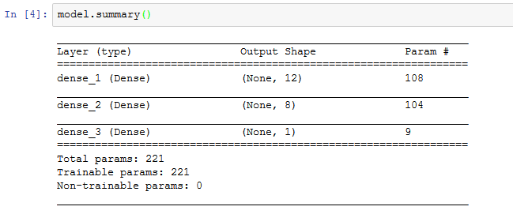
3. Print Model Summary
Great Information about Your Model
model.summary()

Slide 43
4. Compile Your Model
Compiling the model uses the most efficient numerical libraries in the backend
The backend automatically chooses the best representation of the network for training and making predictions for your hardware, such as CPU or GPU, or even distributed
We must specify some additional properties required for training
Training a network means finding the best set of weights to make predictions for the problem
Optimization problem

Slide 44
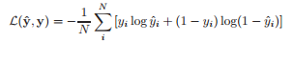
4. Compile Model
What do we optimize?
Need the function to optimize (minimize)
For classification problems it is typically the loss function [loss = true - predicted]
Variables are the different weights and biases in the model (network) - synapses
For this problem the logarithmic loss function is the “objective function”
Defined in Keras as “binary_crossentropy“

Slide 45
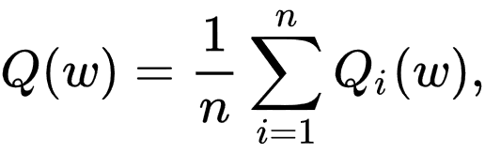
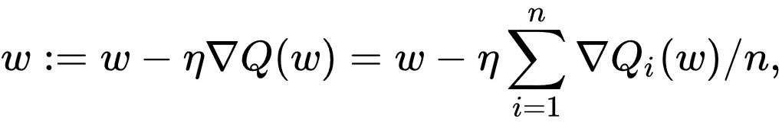
4. Compile Model
Define Optimization algorithm:
Gradient descent algorithm “adam” (Adaptive Moment Estimation)
Good place to start (very common optimizer for learning)
In adam, the learning rate h, is reduced over time (also called the step size)
Reduce the step size as we approach the optimal solution

Slide 46
4. Compile Model
In addition to an objective, we will collect other “metrics” to monitor
By default Keras reports loss
There’s no one-size-fits-all loss function to algorithms in machine learning
Since we minimizing, we want the loss function to go down
We will also report the classification accuracy as a metric
Accuracy is the percentage of “correct” answers

Slide 47
4. Compile Model
# Compile model
model.compile(loss='binary_crossentropy’,
optimizer='adam’, metrics=['accuracy'])
“metrics” is a list of additional things that we want to track (in addition to loss)
Accuracy is almost always tracked
Available metrics:
binary_accuracy
categorical_accuracy
sparse_categorical_accuracy
top_k_categorical_accuracy
sparse_top_k_categorical_accuracy
Custom metrics

Slide 48
5. Fit Model (Train!)
We train or fit our model on the loaded data by calling the fit() function on the model
Training process will run for a fixed number of iterations through the dataset
One pass through all of the data is called an epoch
We must specify using the number of epochs (nepochs)
We can also set the number of data points that are evaluated before a weight update in the network is performed
“Batch size” using the batch_size argument
Accumulates the error during the batch
Averages error over the batch
One back propagation for entire batch

Slide 49
5. Fit Model (Train!)
# Fit the model
history = model.fit(X, Y, epochs=150,
batch_size=10)
For our problem, we will use 150 epochs (relatively small)
Batch size of 10
These can be chosen experimentally by trial and error
Batch size can help performance a great deal
It can impact how quickly the model converges
Overall, use a larger batch size, particularly for large data sets (runs faster)
For GPUs, recommended to make batch size to fit as much data in GPU memory as possible

Slide 50
5. Fit Model (Train!)
A “batch” is the number of pieces of data run through the model (feed-forward)
The error using backpropagation is “averaged” over the number pieces of data
This can slow learning a bit, but greatly improves epoch time
As optimizer works through data (epochs) it will randomize the order of the training data
Varies with epoch
Create more robust trained model since the error will vary
Prevents “overfitting”
Overfitting is where the model works VERY well on training data but terrible on test data
It “memorizes” the training data set

Slide 51
5. Fit Model (Train!)
For this problem, the model is trained on entire dataset (small dataset)
Not really a problem since we are just learning
We can evaluate the performance of the network on the same dataset
Give us an idea of how well we have modeled the dataset (e.g. training accuracy), but no idea of how well the algorithm might perform on new data
You could separate your data into training and test datasets
Training dataset for training model
Testing dataset is used to evaluate model on “unknown” data (after training)
Evaluating the model using the training data is something of a pointless exercise

Slide 52
6. Evaluate Model
# evaluate the model
scores = model.evaluate(X, Y)
print("\n%s: %.2f%%“
%(model.metrics_names[1], scores[1]*100))
Evaluation = input data into trained model
You can evaluate your model on your training dataset using the evaluate() function on your model and pass it the same input and output used to train the model
We are not training the model but “testing it”
Evaluating the test data may be somewhat pointless but the point is to understand how to evaluate new data using the trained model.

Slide 53
TRAINED
Congratulations – you just trained your first Deep Learning Model!!!
Pick up your laminated certificate upon leaving ☺
Seriously – congratulations!!!

Slide 54
Additional Information

Slide 55
Visualizing the History
It would be nice to visualize loss function vs. epochs (progress of training)
Accuracy vs. epochs, loss vs. epochs
In Keras, “history” callback records all training metrics for each epoch
Includes the loss and the accuracy
Returned from calls to the fit() function
Metrics are stored in a dictionary in the history of the object
Notes:
https://datascience.stackexchange.com/questions/20469/keras-visualizing-the-output-of-an-intermediate-layer

Slide 56
Visualize Training History
…
# Fit the model
history = model.fit(X, Y, epochs=150, batch_size=10)
# list all data in history
print(history.history.keys())
…
dict_keys(['loss', 'acc'])
“Output” is in history object (dictionary)
Take a look at what “keys” are in the dictionary
Metrics (loss and accuracy)
This is for the training dataset – we don’t have a test or validation set (yet)

Slide 57
Visualize Training History
import matplotlib.pyplot as plt
# summarize history for accuracy
plt.plot(history.history['acc'])
plt.title('model accuracy')
plt.ylabel('accuracy')
plt.xlabel('epoch')
plt.legend(['train'], loc='upper left')
plt.show()
# summarize history for loss
plt.plot(history.history['loss'])
plt.title('model loss')
plt.ylabel('loss')
plt.xlabel('epoch')
plt.legend(['train'], loc='upper left')
plt.show()
Create plots using matplotlib
Plot accuracy history
Plot loss history

Slide 58
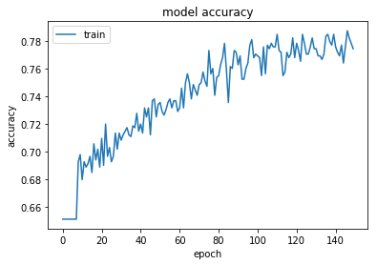
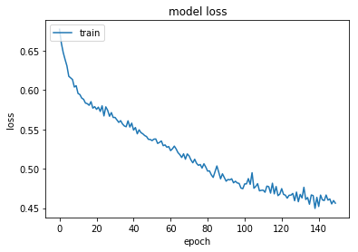
Visualize Training History
Don’t worry about the results for now

Slide 59
Model Summary

Slide 60
Model Summary
model.summary()
...
Model: "sequential_1"
_________________________________________________________________
Layer (type) Output Shape Param #
=================================================================
dense_1 (Dense) (None, 12) 108
_________________________________________________________________
dense_2 (Dense) (None, 8) 104
_________________________________________________________________
dense_3 (Dense) (None, 1) 9
=================================================================
Total params: 221
Trainable params: 221
Non-trainable params: 0
_________________________________________________________________
A text-based summary of model

Slide 61
Overall Summary

Slide 62
Summary
Keras is a great way to get started with Deep Learning
Fairly easy to create a Fully Connected Network model (FCN)
Just a few lines of Python
Several steps
Various tools/options to help train the model and visualize history
Next steps – Advanced Options

